Slide 1
Chapter 10
Android Architecture component
https://developer.android.com/topic/libraries/architecture/viewmodel
https://developer.android.com/topic/libraries/architecture/livedata

Slide 2
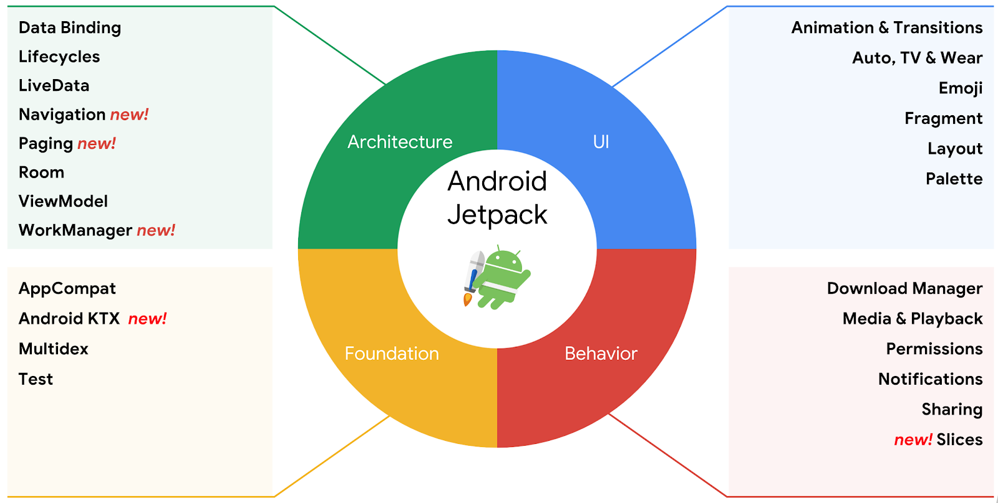
Android Jetpack
Android Jetpack is a set of components, tools and guidance to make great Android apps.
Ref: https://github.com/android/sunflower

Slide 3
Key points of Android Architecture components
Android architecture components are a set of libraries to help with various challenges in dealing with Android Architectures.
Room handles database persistence.
Lifecycle helps you create components that are aware of the current Android lifecycle state.
ViewModel holds data and survives configuration changes.
LiveData provides observable data to views.
Data binding allows Android Views to observe changes to data in XML.
Paging handles displaying infinite lists.
Navigation handles complex navigation.
WorkManager manages background tasks.
Ref: https://www.raywenderlich.com/books/advanced-android-app-architecture/v1.0/chapters/4-android-architecture-components

Slide 4
Use Case
Consider the situation where you are building an application that supports different orientations, such as landscape and portrait, and supports multiple languages.
What tends to happen in these scenarios by default is that when the user rotates the screen, the activities and fragments are recreated for the new display orientation.
Now, imagine that happens while your application is in the middle of processing data. You have to keep track of the data you are processing, you have to keep track of what the user was doing to interact with your screens, and you have to avoid causing a context leak.

Slide 5
Configuration changes
Screen rotation
Keyboard changes
Language changes
Enabling multi window

Slide 6

ViewModel
The ViewModel class is designed to store and manage UI-related data in a lifecycle conscious way. The ViewModel class allows data to survive configuration changes such as screen rotations.

Slide 7
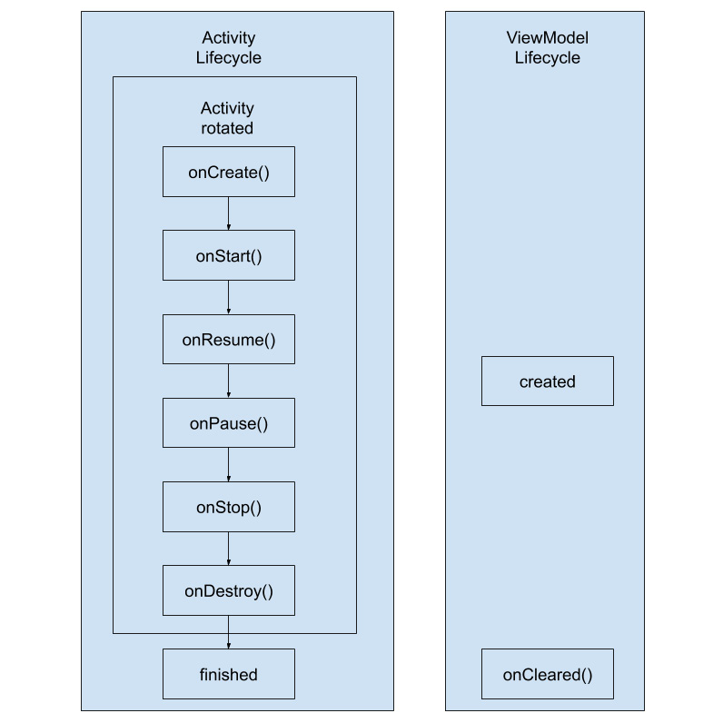
ViewModel LifeCycle
In the following diagram, you can see that a ViewModel can be created at any point in an activity's life cycle (in practice they are normally initialized in the onCreate for Activities and onCreateView or onViewCreated for Fragments because these represent the points where the views are created and ready to be updated), and that once created, it will live as long as the activity does:

Slide 8
CA13: ViewModel
Once it is done submit pdf in canvas

Slide 9
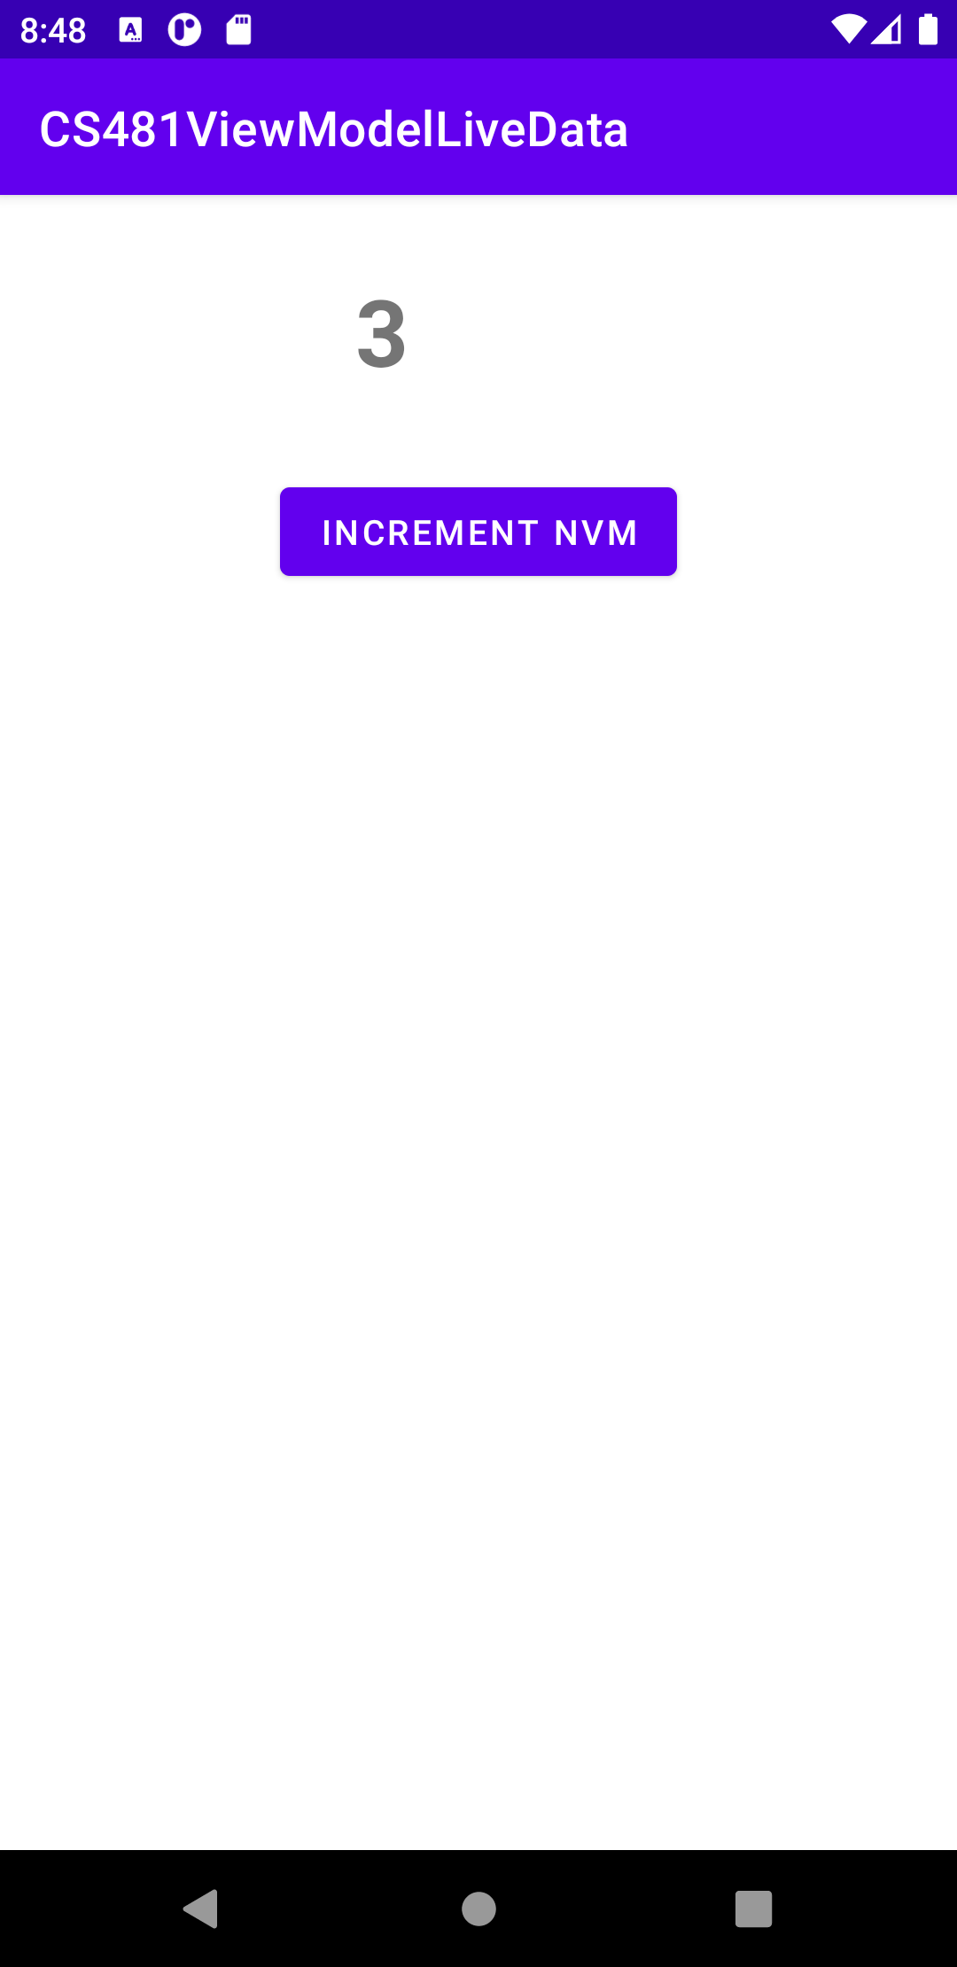
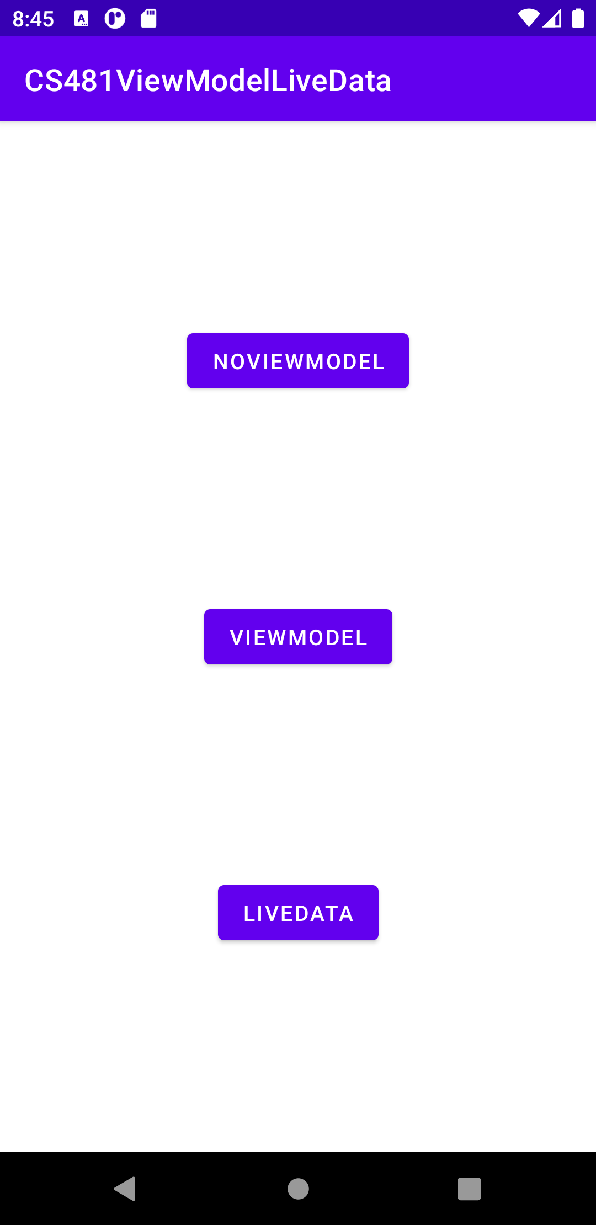
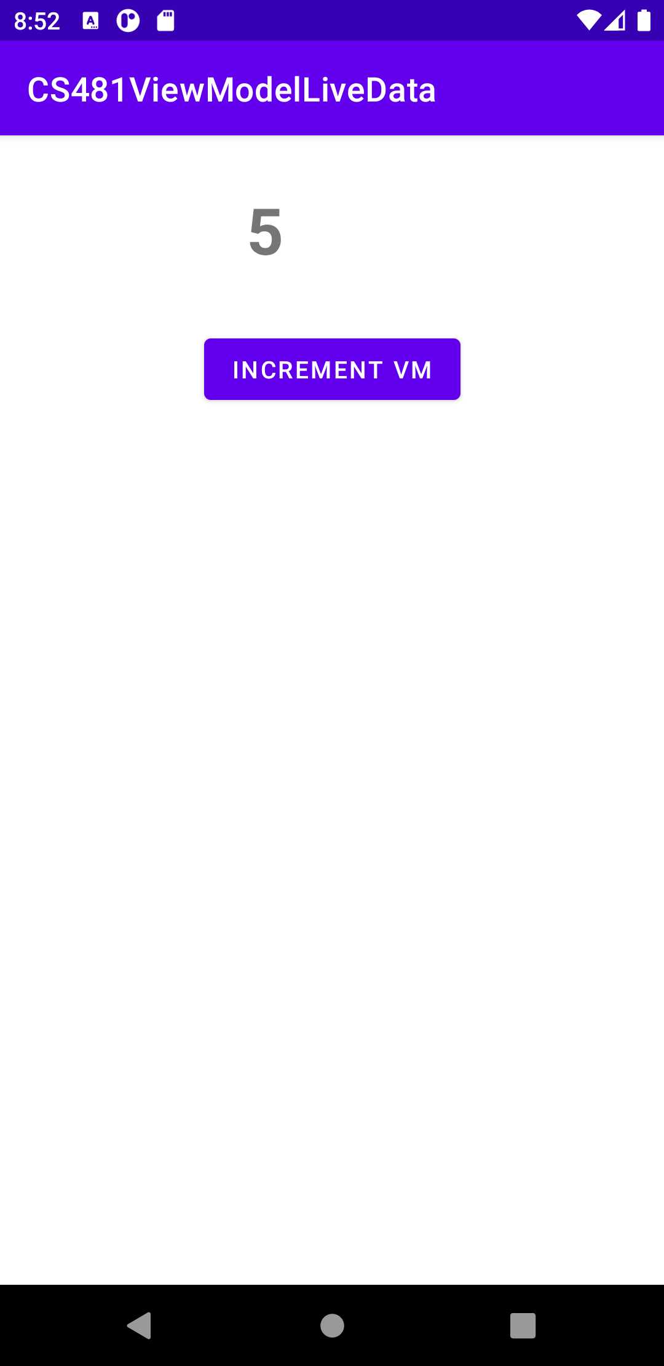

activity_main.xml

Slide 10
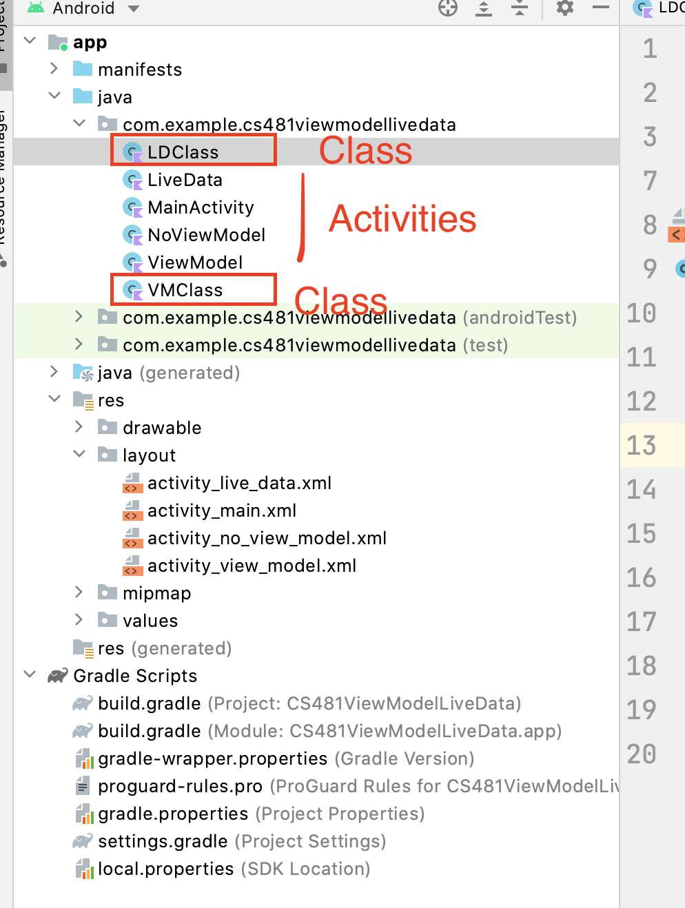
Task To Do
Add 3 Empty Activities: NoViewModel, ViewModel, LiveData
Create 2 classes (VMClass, LDClass) and extend ViewModel()
class VMClass : ViewModel() {}
class LDClass : ViewModel() {}

Slide 11
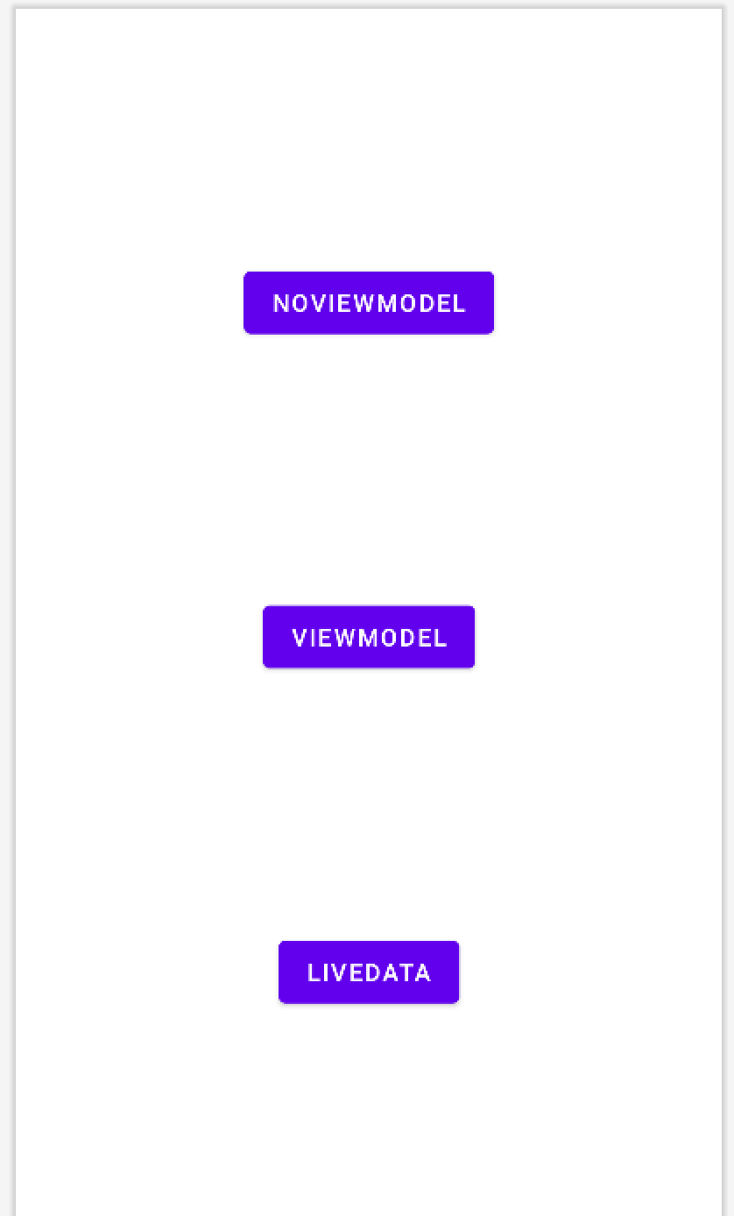
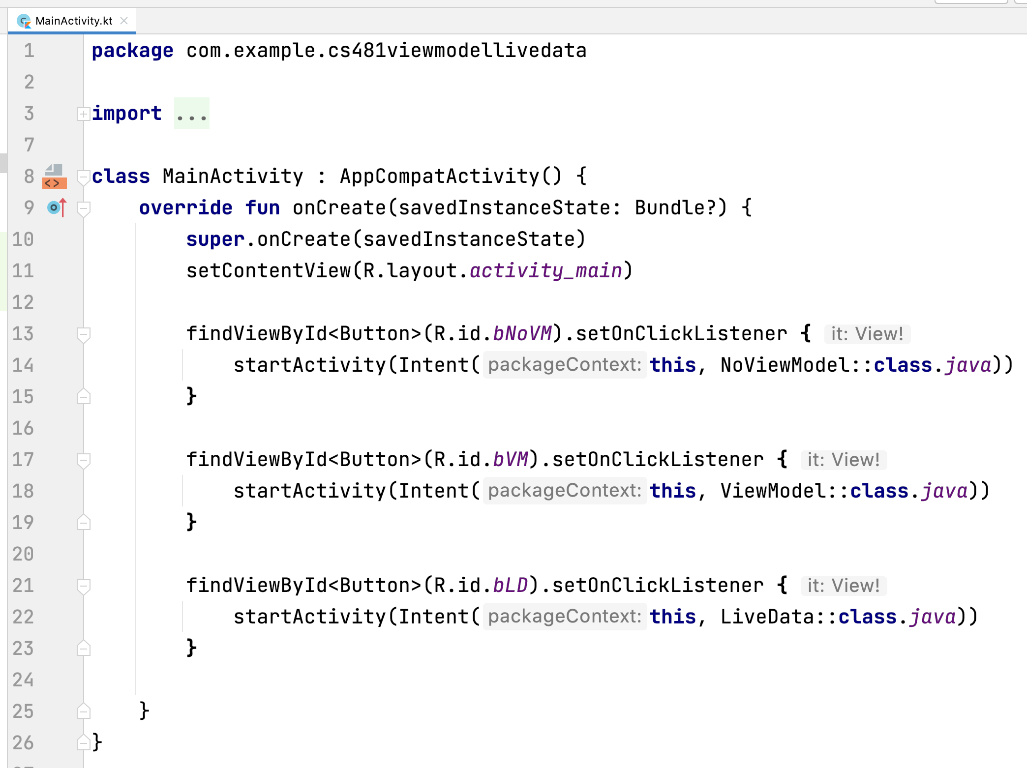
MainActivity

Slide 12
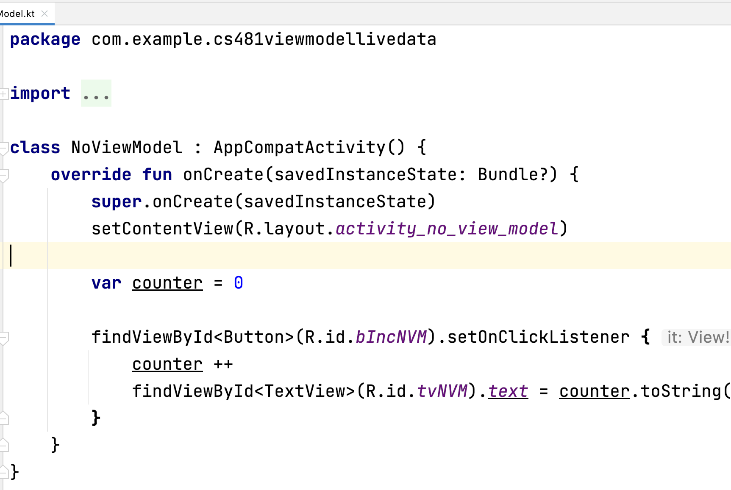
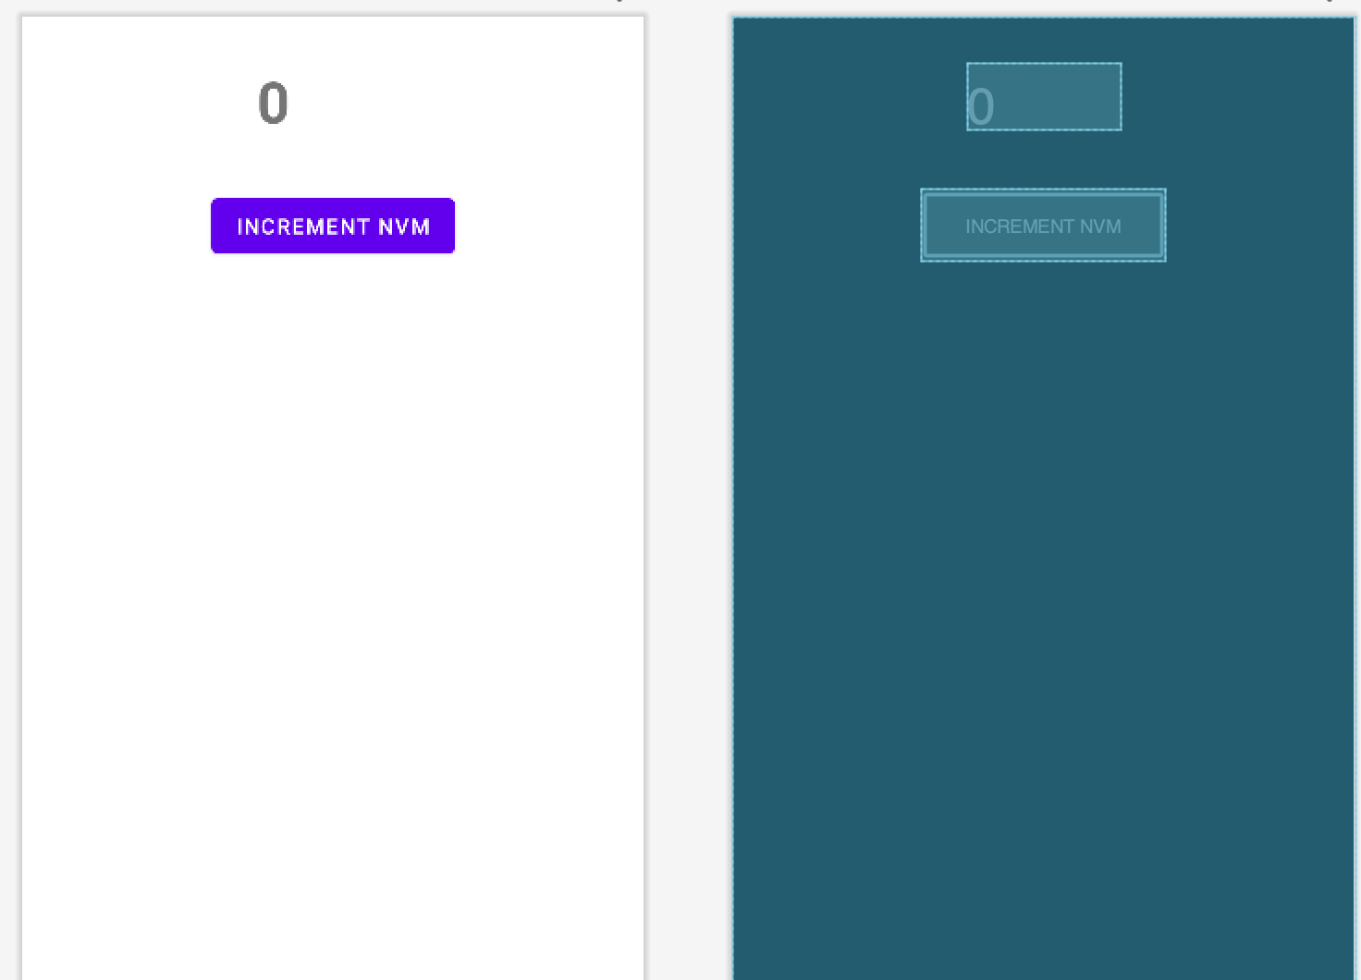
NoViewModel

Slide 13
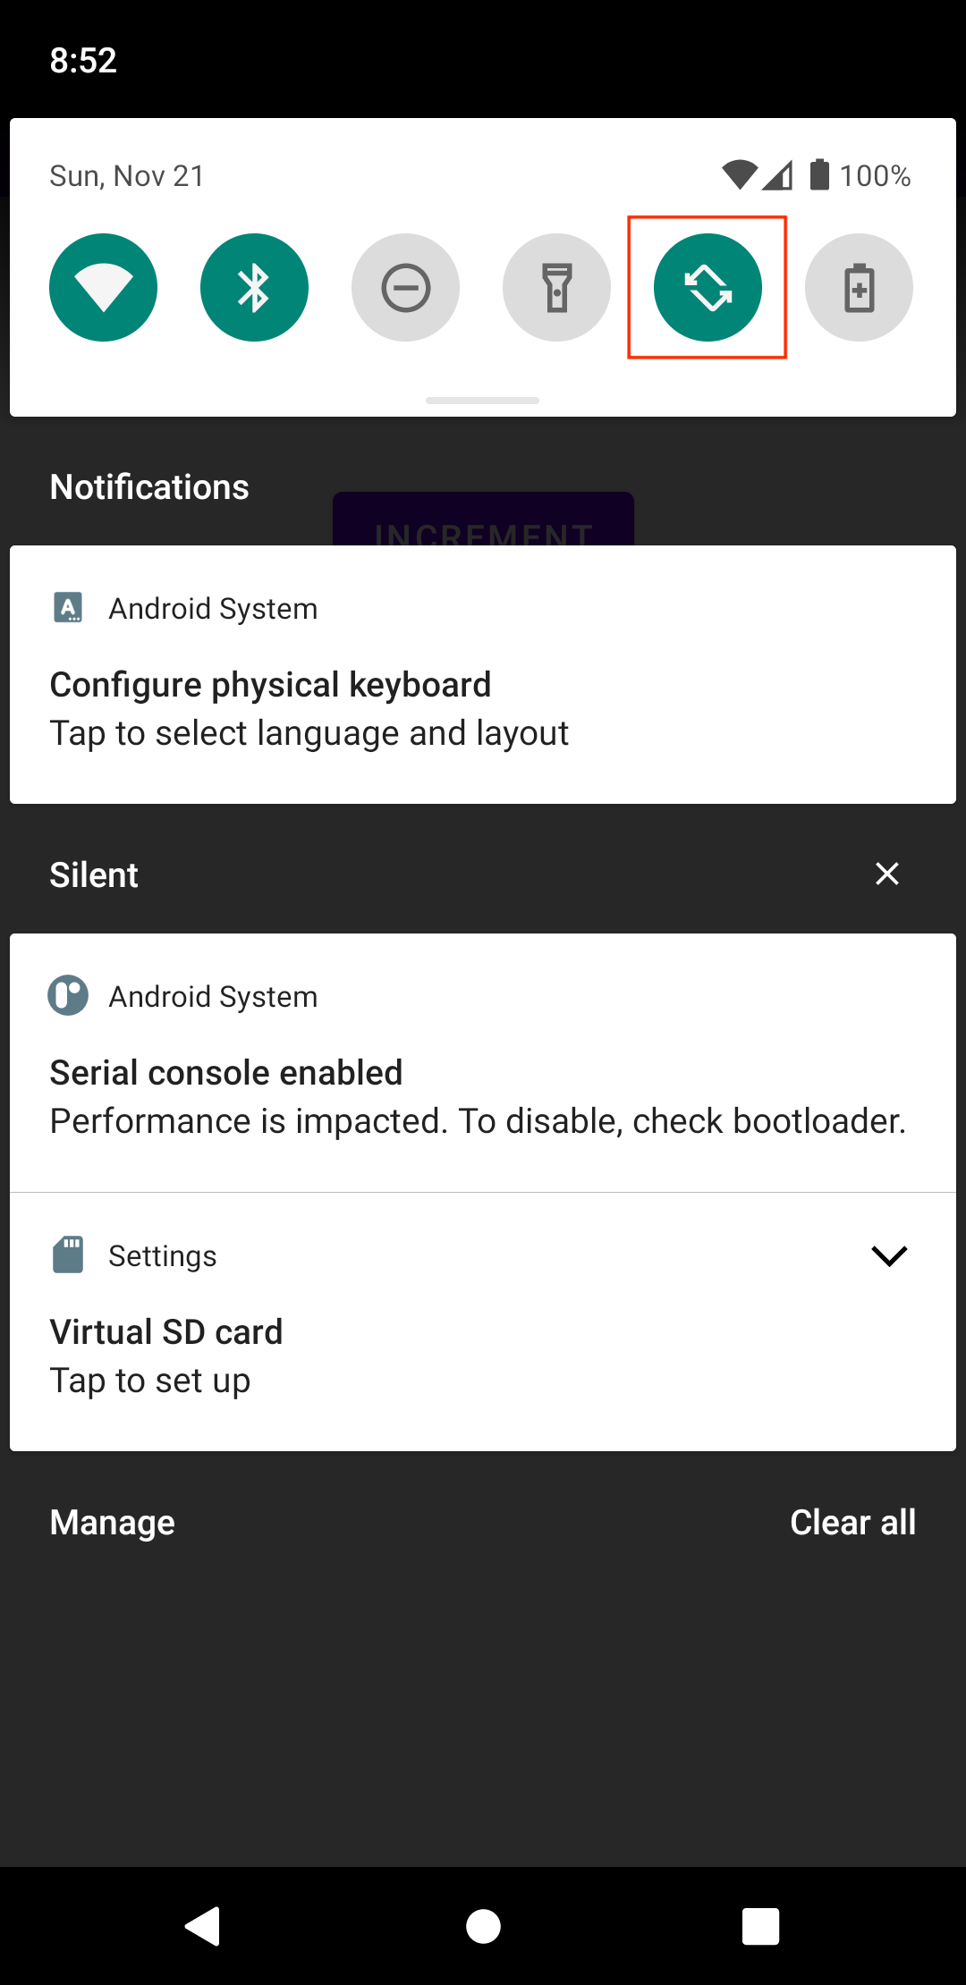
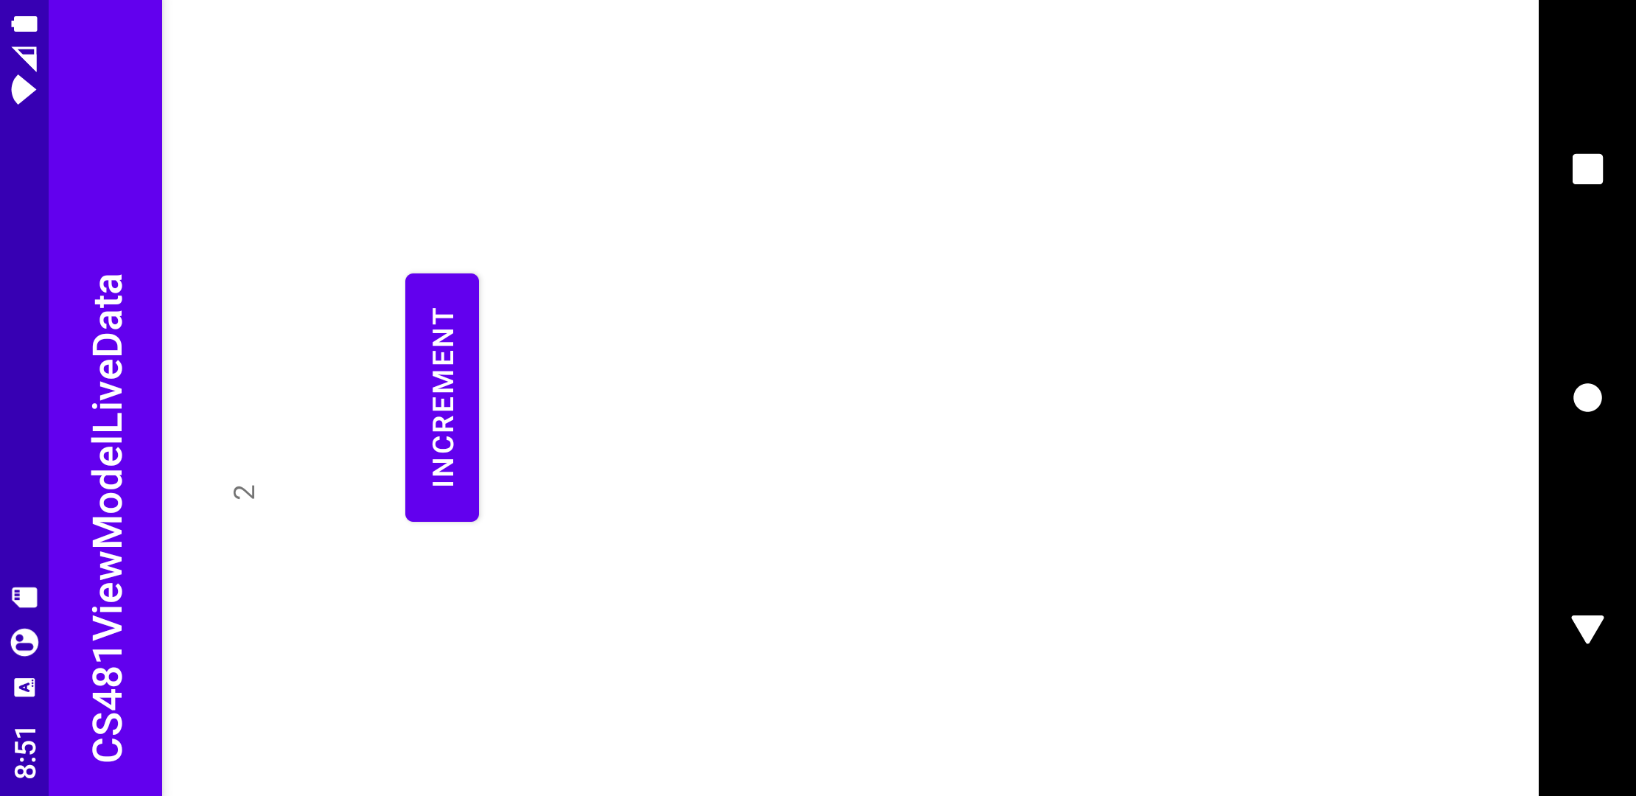
Auto Rotate Enabled

Slide 14
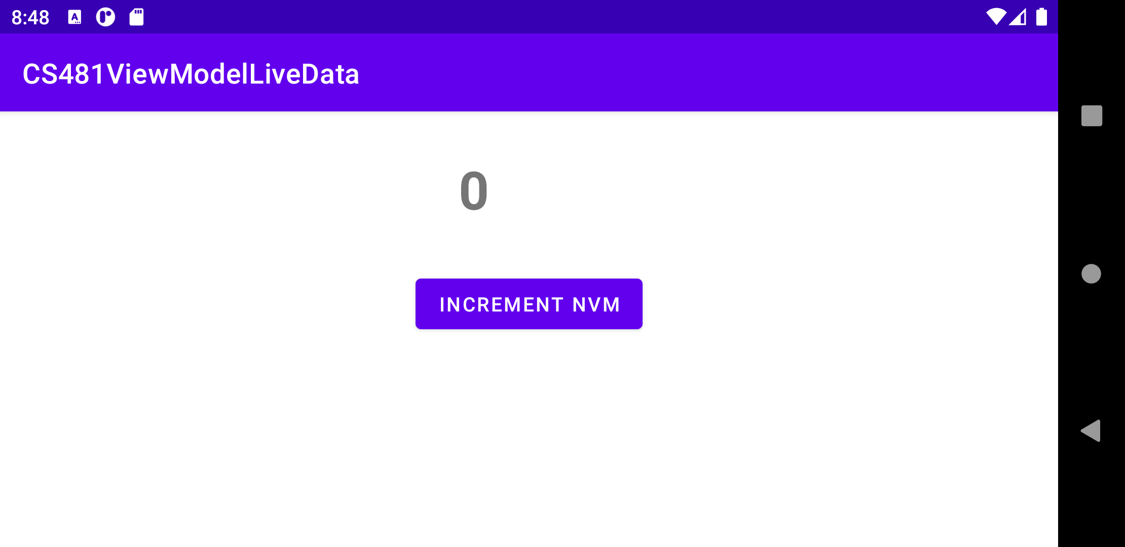
Problem of NoViewModel
Counter reset to 0 when screen rotate.

Slide 15
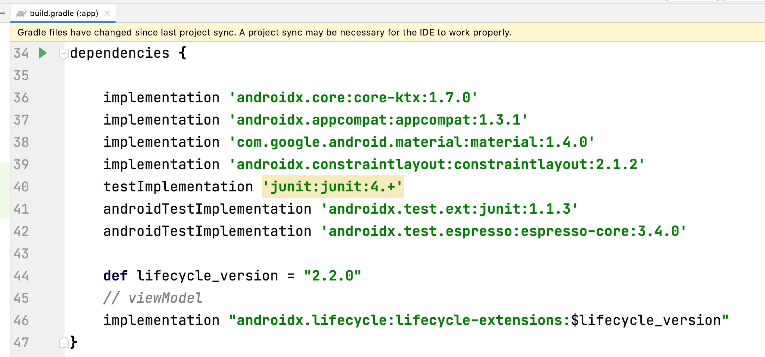
ViewModel Dependencies

Slide 16
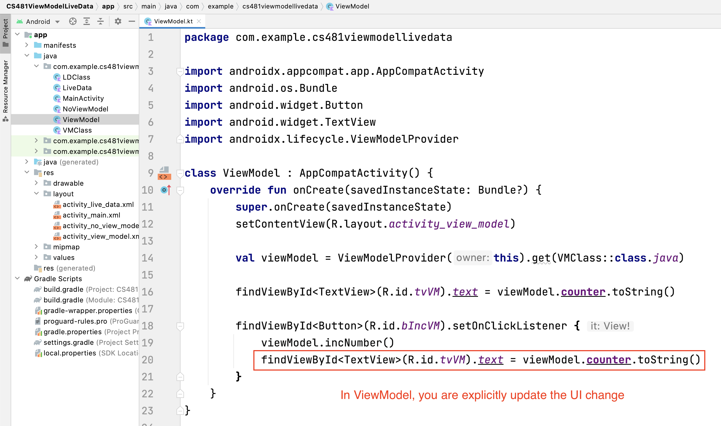
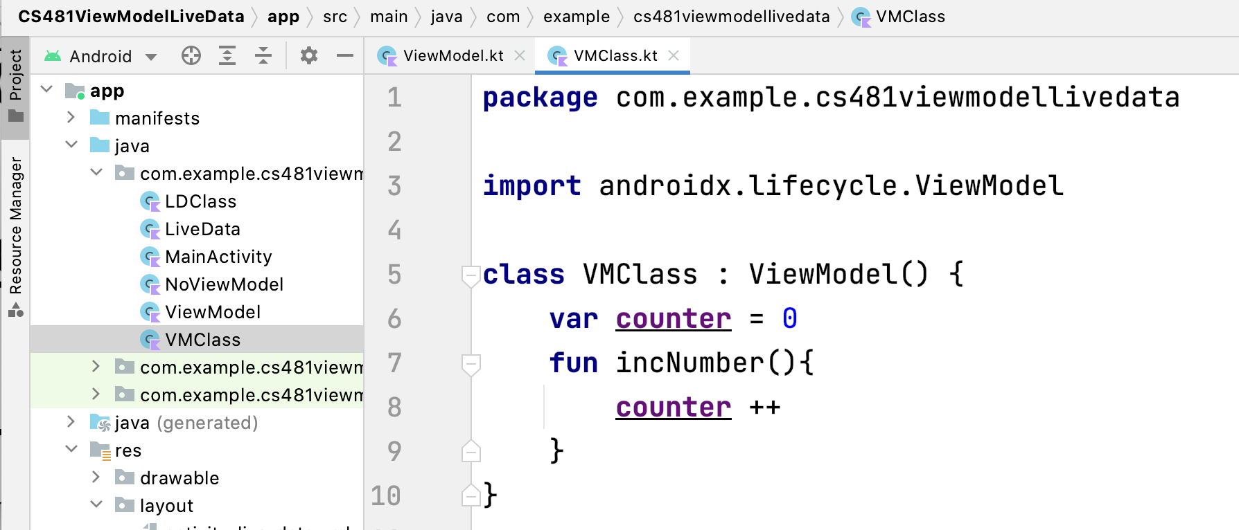
VMClass and ViewModel Activity

Slide 17

LiveData
LiveData is an observable data holder class. Unlike a regular observable, LiveData is lifecycle-aware, meaning it respects the lifecycle of other app components, such as activities, fragments, or services. This awareness ensures LiveData only updates app component observers that are in an active lifecycle state.

Slide 18
Key Advantages of LiveData
Ensure your UI matches your data state
No memory leaks
No crashes due to stopped activities
No more manual lifecycle handling
Always up to date data
Proper configuration changes
Sharing resources

Slide 19
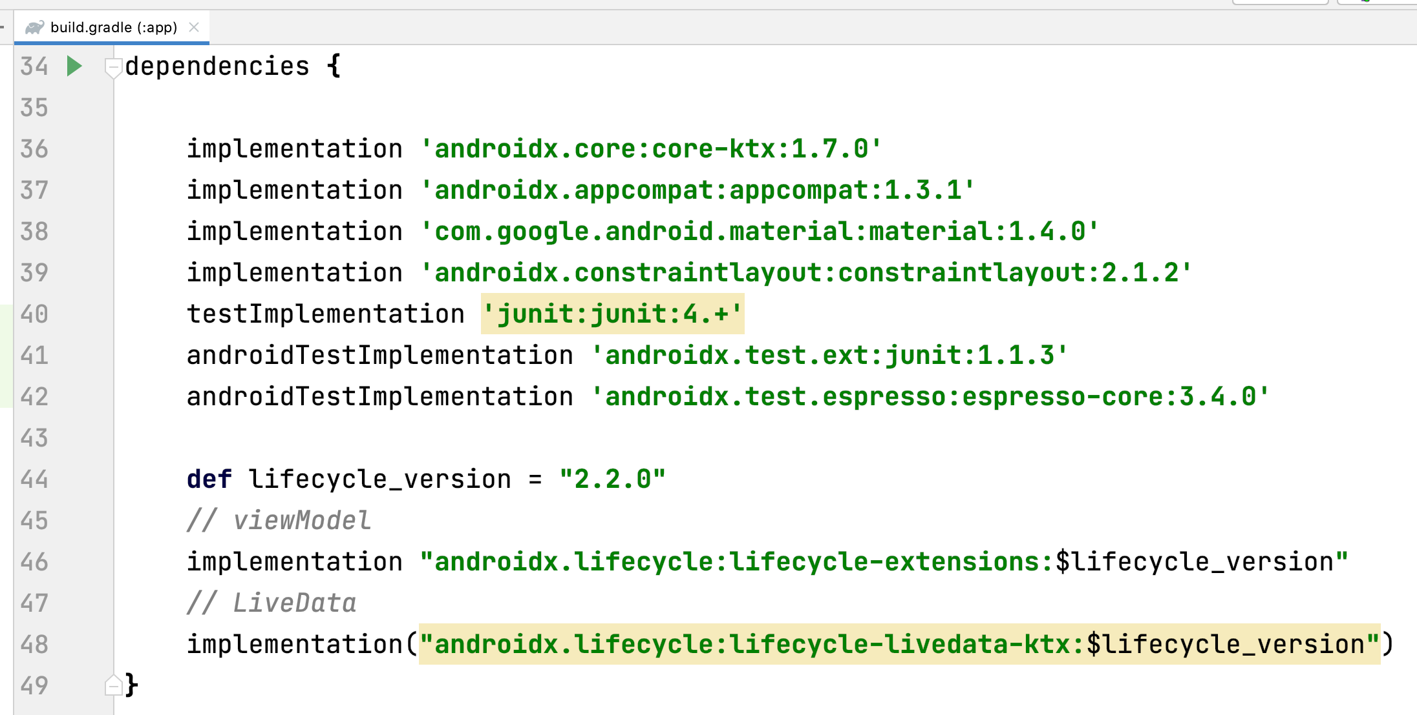
LiveData Dependencies

Slide 20
Work with LiveData objects
Create: Create an instance of LiveData to hold a certain type of data. This is usually done within your ViewModel class.
Observe: Create an Observer object that defines the onChanged() method, which controls what happens when the LiveData object's held data changes. You usually create an Observer object in a UI controller, such as an activity or fragment.
Update: Attach the Observer object to the LiveData object using the observe() method. The observe() method takes a LifecycleOwner object. This subscribes the Observer object to the LiveData object so that it is notified of changes. You usually attach the Observer object in a UI controller, such as an activity or fragment.
Ref: https://developer.android.com/topic/libraries/architecture/livedata

Slide 21
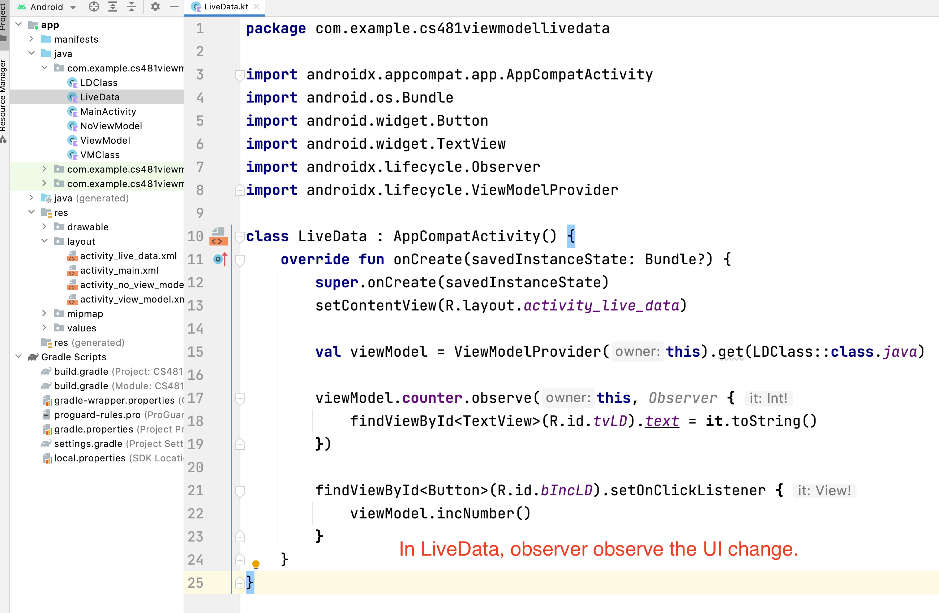
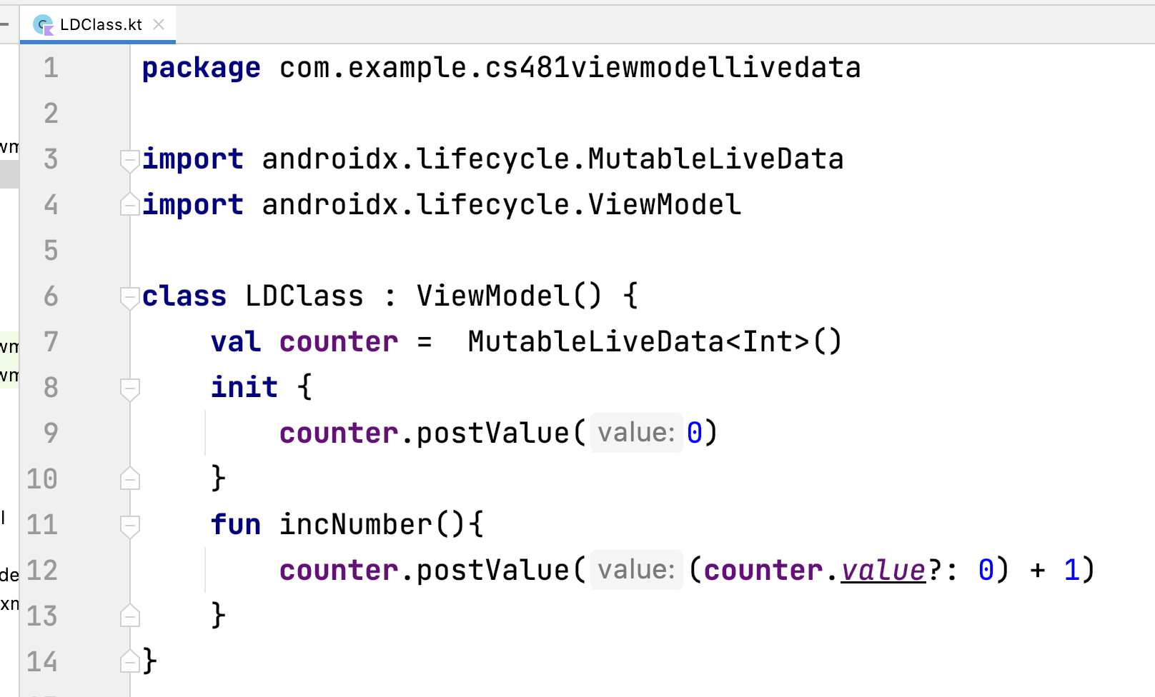
LiveData Class and Activity

